Slide 1



Rosetta Stone Project
By: Ryan Redjaian, Luis Rivas, King Nguyen, Paul Zhao, Etai Eilat, and Todd Hartog

Slide 2
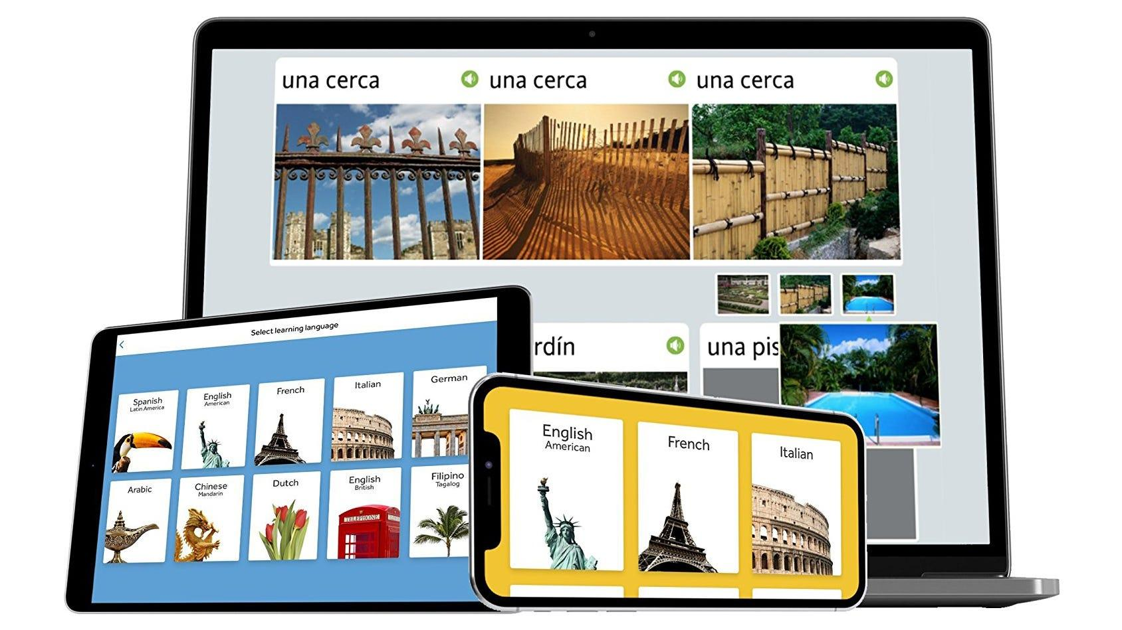
Rosetta Stone Business Growth
Language-learning software
Subscriber Optimization
Determine most valuable subscribers
Determine additional products
Identify barriers to deeper subscriber
acquisition
Outline future business opportunities
Notes:
The primary objective of this project for us was to ultimately contribute to the growth of Rosetta Stone’s business goals.
Our strategic approach involved tasks Our strategic approach involved tasks such as discerning the most valuable subscribers, conducting a nuanced analysis of the diverse subscriber segments present in the database, pinpointing subscribers with potential for additional product or service uptake, detailing subscriber profiles, identifying potential barriers hindering deeper engagement, and presenting insightful business opportunities derived from our comprehensive analysis. This concerted effort aimed to provide Rosetta Stone with a roadmap towards meeting and exceeding its business growth expectations.

Slide 3
Data Cleaning
Challenges with the data
Missing currency values, labeled as ‘None’
Missing values for engagement metrics, filled with zeros, assuming no engagement
Big jump from values in the $900s straight to millions$ for ‘Purchase Amount USD’ (1491 rows of data), removed outliers
Removed rows with missing values for ‘App Session Date’
Converted dates to ‘datetime’ format
Categorical columns with missing values were filled with ‘Unknown’
For columns with binary variables, converted ‘Yes/No’ entries to boolean values
Filled missing values in ‘Auto Renew’ with ‘False,’ assuming the feature was not used
Notes:
Ryan

Slide 4
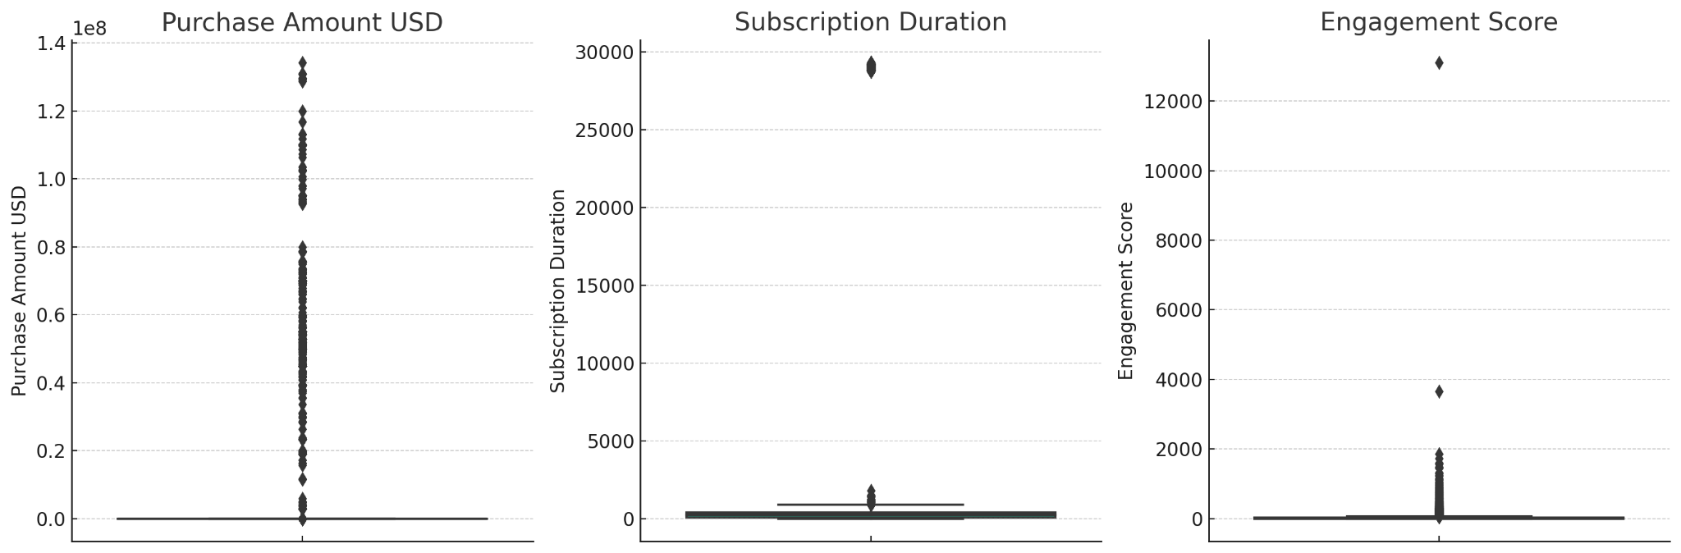
Data Cleaning
New Columns Created
Purchase Amount USD - used approximate exchange rates from time period to convert to common currency
Subscription Duration - calculated from the start and end date columns
Engagement Score - created by adding up various engagement metrics like email opens and clicks
Notes:
Ryan

Slide 5
Most Valuable Clusters
Created a kmeans clustering model on `Purchase Amount USD` on the our final cleaned dataset.
Cluster 1: low spenders
Cluster 2: middle spenders
Cluster 3: high spenders (most valuable customers)
Average purchase amounts in usd by cluster:
Purchase Amount USD by Cluster
 | 1 | 2 | 3
Value | $16 | $179.68 | $332.13
Notes:
To determine most valuable subscribers, we decided to create a kmeans clustering model on Purchase Amount USD variable. We ended up with 3 clusters, with cluster 3 being our most valuable customer with having on average the highest purchase amount, with cluster 2 being the middle spenders, and cluster 1 being the low spender, probably people who were just with us right after the free trial or quit after a couple months.

Slide 6
Subscription Duration Characterizes Subscriber Segments
Subscription duration is a reliable indicator to determine if a customer is a high, middle or low spender.
Users who spend more have longer subscription durations (note the longer durations means more lifetime subscriptions)
Average Subscription Duration by cluster:
Subscription Duration by Cluster
 | 1 | 2 | 3
Value | 1,618.3 | 20,800.7 | 24,271.6
Notes:
Looking more deeply into the clusters,we wanted to look at their subscription duration as we believe people who are with us for longer are more valuable. Looking at clusters 2 and 3, they have really large values, mostly due to them having lifetime subscriptions.
Clusters 2 and 3 have more lifetime subscriptions

Slide 7
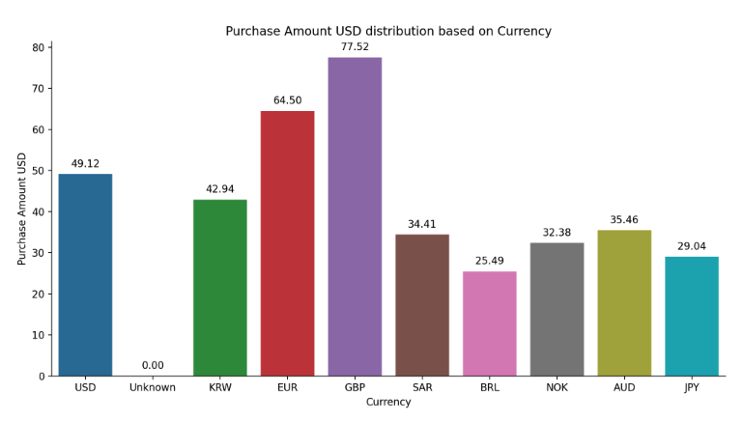
Most Valuable Customers use EUR/GBP/USD
All high value customers pay in either EUR, GBP, or USD. All users spending with every other currency are in the low spending cluster.
Currencies by Cluster
 | 1 | 2 | 3 | Cluster 3 % of Total
EUR | 2579 | 462 | 81 | 2.59%
GBP | 2026 | 244 | 81 | 3.45%
USD | 13831 | 5989 | 99 | 0.50%
Other | 13218 | 1 | 0 | 0.00%
Notes:
We wanted to see where our customers are purchasing from, so we decided to see the currencies used. In cluster 3, our most valuable subscribers, they were all using the Dollar, Pound, or Euro. We also noticed that as a percentage of total users using that currency, we had more valuable subscribers coming from overseas rather than America.

Slide 8
Additional Characteristics of High Valuable Customers
Higher value customers are more likely to have auto renew off
Auto renew off ratio > auto renew on ratio (cluster 3)
People outside the US/Canada are more likely to be higher value customers
Having the most users does not equate to the most individual spending
Non-consumers are more likely to be higher value customers
Auto-Renew by Cluster
 | 1 | 2 | 3
Off | 20092 | 5452 | 239
On | 11562 | 1243 | 22
Country by Cluster
 | 1 | 2 | 3
Europe | 4172 | 427 | 93
Other | 11394 | 3170 | 134
US/Canada | 16088 | 3099 | 34
User Type Cluster
 | 1 | 2 | 3
Consumer | 22031 | 3565 | 131
Other | 9623 | 3131 | 130
Notes:
Some additional characteristics we noticed from high valuable customers is that they are more likely to have auto renew off, which falls in line with the assumption that they are mostly lifetime subscribers. Also looking more deeply into the country they’re from, we noticed that a higher percentage are in Europe. We also found that non-consumers like institutions and schools, are more likely to be higher value customers, which makes sense as they buy in bulk and constantly are using it every year.

Slide 9
More High Value Customer Characteristics
Non-App users are more likely to be high value users
People with push notifications off are more likely to be high value customers
Higher value customers have higher open counts
Lead Platform by Cluster
 | 1 | 2 | 3
App | 12795 | 1000 | 28
Unknown | 9345 | 2989 | 125
Web | 9514 | 2707 | 108
Push Notifications by Cluster
 | 1 | 2 | 3
No | 9347 | 2990 | 125
Yes | 22307 | 3706 | 136
Open Count Amount by Cluster
 | 1 | 2 | 3
Value | 4.3 | 14.1 | 8.6
Notes:
Lastly we found that non-app users are more likely to be high value users, which makes sense if a lot of institutions are buying them, similarly to why push notifications off are more likely to be high value. And lastly higher value customers have higher open counts.
So just to quickly summarize, we believe the higher value customers are those who spend the most on the app. We discovered that most of them are lifetime subscribers, and from overseas. We can use these findings to obtain more high value customers, which we’ll get into at the end.

Slide 10
Subscribers who purchase additional services
Frequent App Engagement (app session count): Customers who frequently utilize Rosetta Stone products through active app sessions are likely to possess a heightened awareness of forthcoming services.
Language-Based Targeting: Analyzing historical subscription renewal rates across different languages provides valuable insights. Investing in advertising for languages with robust renewal rates is strategic, as it aligns with the potential shared goals and interests within these language-specific user segments.
Auto-Renewal Engagement: Subscribers who have opted for auto-renewal demonstrate an ongoing commitment to the product, enhancing their likelihood of being well-informed about future services.
Free trial / Demo User Engagement: Customers currently engaged in a free trial or demo phase present an attractive target audience for future service advertisements, as their initial interest makes them receptive to exploring additional offerings.
Notes:
Ryan
General insights about the data

Slide 11
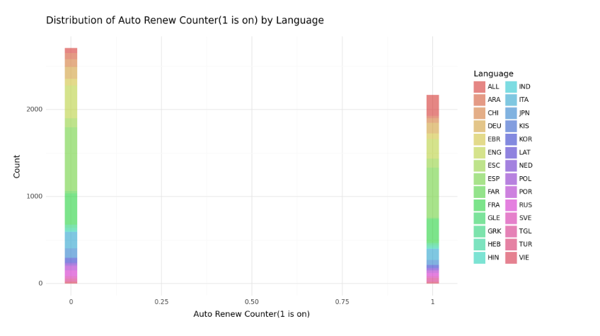
Language Distribution with Auto Renew
Notes:
Ryan
Paul
More people learning spanish that have auto renew on
Some languages have stronger renewal rates meaning there could lead to more investment in advertisement with these languages

Slide 12
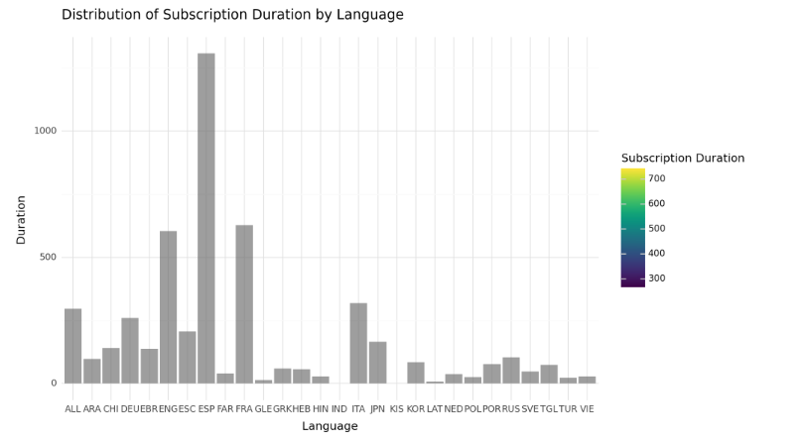
Longest Subscription Durations by Language
Notes:
Ryan
Paul
Graph of subscriber duration by language is identical to graphs as app session count, subscription type event (limited or lifetime) so you can say the insights and that they apply to all the bolded variables in relation to the language
Strong dominance in spanish, make future products for spanish, but this could also tell us to allocate more money towards languages that are not as prevalent on the platform
-spanish had highest app session count as well as most lifetime users, french and english are second and third

Slide 13
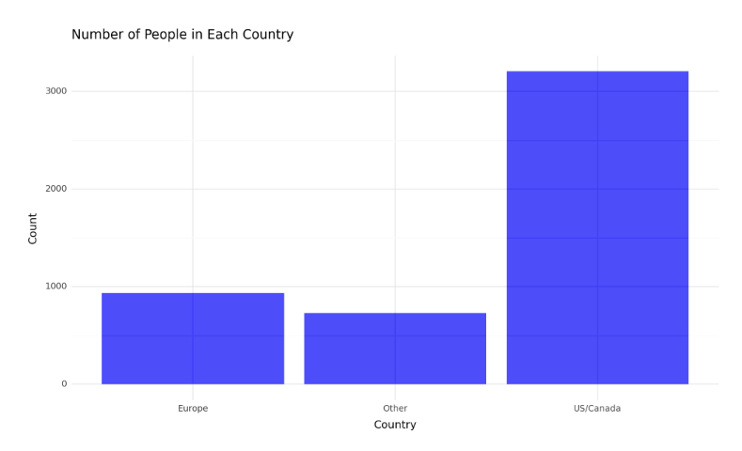
Users by Region
Notes:
Ryan
Same thing here, the graph applies for
US and Canada have the highest subscribers, target advertising in those areas more

Slide 14
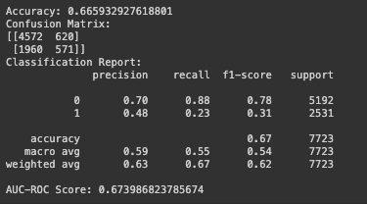
Subscribers Who Purchase Additional Services
Target Variable: Auto Renew
App session count: customers who use the software at a high rate are more likely to branch out and try other additional Rosetta Stone services
Engagement score: customers who have a higher engagement rate are more likely to purchase future services
Subscription length: customers with a longer subscription length are more likely to use new additional services
Subscription event counter: customers that are renewing their subscription are more susceptible to advertising of Rosetta Stone services
While accuracy is relatively high for the dataset size, the model’s performance may be influenced by class imbalance as indicated by the differences in the classification report. The AUC-ROC score shows that the model could discriminate between the classes properly.
Being able to predict auto-renewal gives a better gauge of long-term customers, meaning that they are more inclined to purchase future software releases and be up to date with Rosetta Stone as a corporation.
Notes:
Ryan
we created a logistic regression with a target variable of auto renew
-features we used were app session count, engagement score
Accuracy: 0.66. The logistic regression model properly predicted the target variable (auto renewal) 66.6% of the time
Confusion matrix:
the model predicted the right class where auto renew is on 4,572 times
Predicted the right class where auto renew is off 1960 times
Incorrectly predicted where auto renew is on 620 times
Incorrectly predicted where auto renew is off 571 times
Precision: ratio of correctly predicted positive observations to the total predicted positives. High precision relates to the low false positive rate
Recall: the ratio of correctly predicted positive observations to all observations. High recall relates to a low false negative rate
F1: weighted average of precision and recall. Ranges from 0 to 1, where 1 is the best possible score
AUC-ROC: the ability to distinguish between positive and negative classes. 0.67 means it can do that moderately well

Slide 15
Subscribers likely to cancel their subscription with Rosetta Stone
Target variable: purchase amount USD
Languages: customers learning less popular languages are more likely to have less comprehensive lessons/content, leading to shorter subscription usage
Auto renew: customers without auto renew are less likely to continue using their subscriptions
Free Trial: customers that have not used the demo or free trial are less likely to purchase or continue their subscriptions
App session count: customers with low app sessions are less likely to continue their subscriptions
Subscription start and end date: customers with short term subscriptions are more likely to cancel their subscription in comparison to those with long term subscription
Notes:
Ryan
-in response to question 4

Slide 16

Ridge Regression Results:
Notes:
Ryan
Talk about what a ridge regression mode does (L2 regression, prevents overfitting, minimize sum of squared differences)
-coefficients we used in this model are subscription type counter, purchase store count, auto renew….
0.0 coefficient means subscription type (limited or lifetime) has less influence on the model
-1.76 suggests a negative relationship. As the number of initial purchases increase, the predicted purchase amount decreases (which makes sense as there would be less renewals)
-27.29, strong negative relationship. Customers who purchase cellular apps gives a significant decrease in purchase amount
Auto renew counter: -0.86 means customers with email subscription is associated with less predicted purchase amounts
-0.31. Customers with notifications on are more likely to witness a decrease in predicted purchase amount
MSE: 666, low in relation to other MSEs and for the size of the dataset. Decent predictive performance
These numbers support Luis’s clustering model as well.
-people who have auto renew on are going to see a higher predicted purchase amount
-

Slide 17
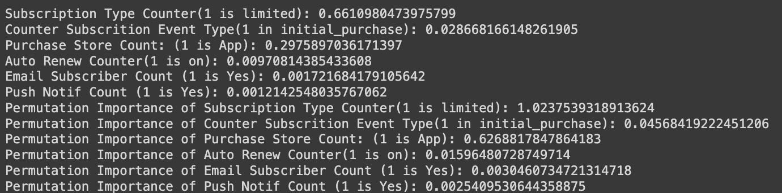
Random Forest Results
Notes:
Etai
Similar to the ridge regression, we also used a random forest to attempt to answer the same question. We also used the same variables here.
We got a high R2 score at about 73%. We got the regular coefficients as well as Permutation importance which is done by randomizing and shuffling the values of the variable and measuring the change in the model. Just from looking at the coefficients, subscription type being limited and purchase being on the app were the strongest. We created a chart to visualize it too.

Slide 18
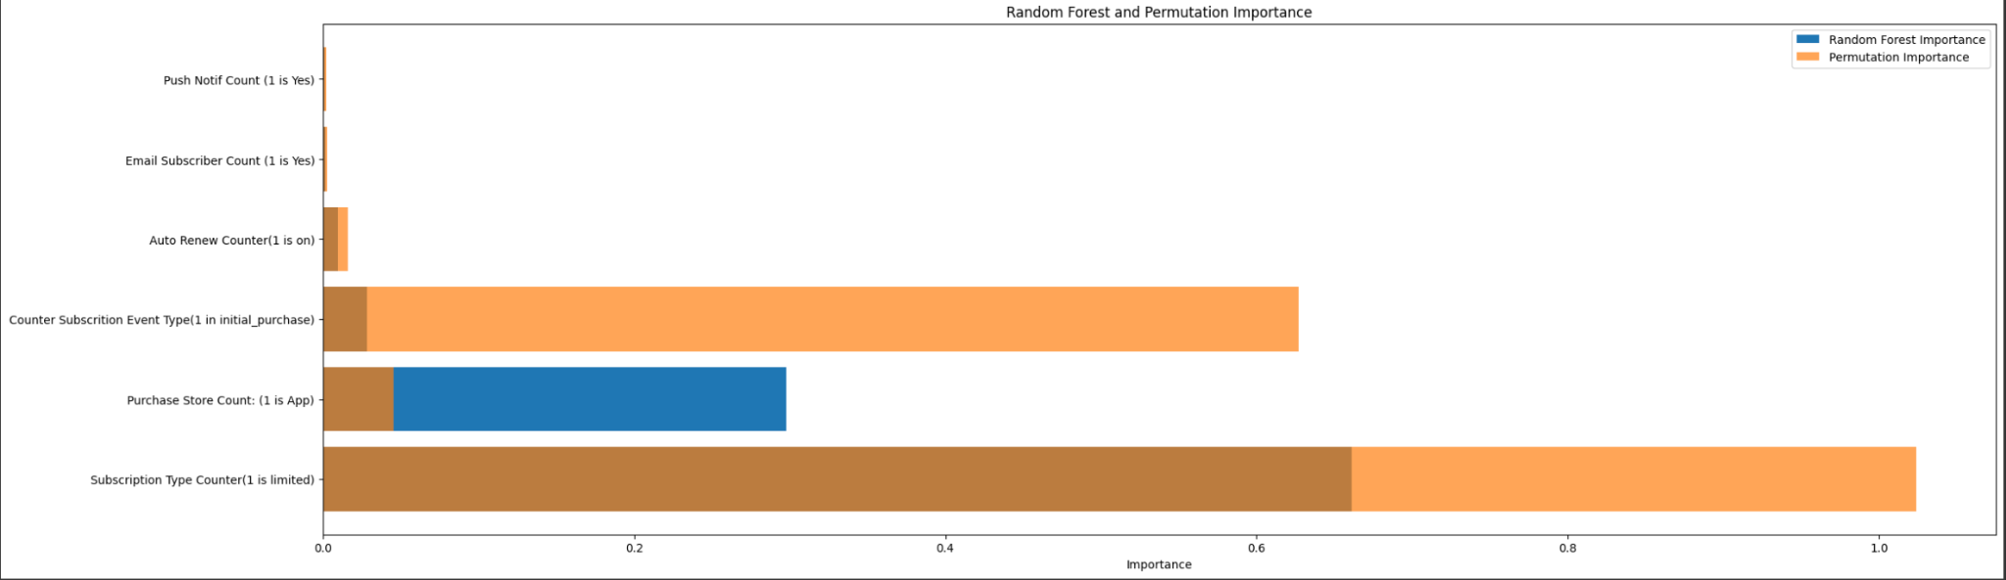
Subscribers unlikely to continue with Rosetta Stone
Notes:
Etai
Being a limited subscriber is super important metric for cancellation because both importance measures are very high in that one.
As well as being initial purchase vs renewing also having a strong importance leading to cancellation which makes sense as those with auto renew on have a lower chance of cancelling.
We also noticed having push notifications on and being an email subscriber has a great chance of them continuing with the product.

Slide 19
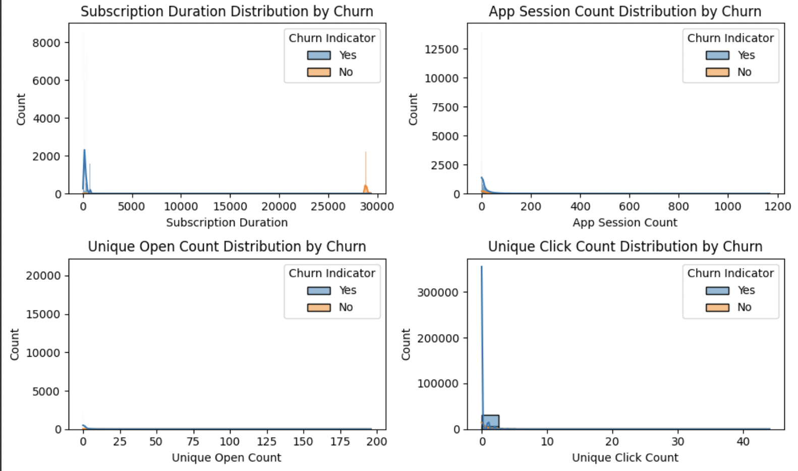
Understanding the User Profile of Discontinued Subscribers
Churn Indicators: Binary variables indicating subscriber discontinuation or continued service usage.
Analysis Observations:
Subscription Duration:
Churned users show shorter durations.
App Session Count:
Majority have low session counts, signifying high disengagement and leading to churning once again
Unique Open & Click Count:
Majority exhibit low opens and click which lead to churning…
Implications for Rosetta Stone's Goals:
Uncovering Challenges: Identifying why users stop using the app is tough. To boost user engagement, we need better overall involvement strategies, like setting up reminders for users or placing customer loyalty based on those with longer subscriptions. Surprisingly, even regular app users might stop, so keeping customers is crucial here in terms of language learning.

Slide 20
Business-relevant opportunities
Targeted Marketing and Personalization:
Idea 1: Tailor marketing strategies by identifying different customer groups ( low, medium, and high spenders) to offer personalized services or products that match their preferences. By focusing on marketing products to specific demographics or high spenders, sales would increase on a global scale beyond the US market.
Idea 2: Analyze engagement with email campaigns to enhance performance of the advertisements. Sending more personalized and engaging emails, notifying customers about special promotions, and incentivizing customers to use the company’s services will help retain subscribers by increasing the retention rate and lowering the churn rate, leading to increased sales. This could have promotions catered to groups of individuals using Rosetta Stone to ensure incentives to make them more likely to keep the app.
Idea 3: Incentivizing customers with low engagement with special promotions through targeted advertisements will help increase the retention rate by preventing some customers from cancelling their subscription. Email and other targeted advertising channels should focus on tailoring the advertisement of the specific customer based on their engagement as a subscriber.
Notes:
Idea 1) also bring up market more for overseas companies as they are seen as the higher value subscribers

Slide 21
Executive Summary
Valuable Subscribers Identified: Our analysis determined that the most valuable subscribers are those with high engagement scores, indicated by frequent email interaction and prolonged subscription durations. These subscribers contribute significantly to revenue and exhibit strong brand loyalty.
Subscriber Segments Unveiled: We grouped subscribers by engagement level, usage patterns, and purchase behavior. Notable segments include highly engaged customers, occasional users, and at-risk subscribers, each with distinct engagement patterns and needs.
Upsell Potential Highlighted: Subscribers with consistent app activity and positive email interaction metrics were identified as prime candidates for upselling. Personalized product recommendations and exclusive offers could be targeted to this group.
Churn Profile and Engagement Barriers: Profiles of users discontinuing product use were characterized by low app session counts and minimal engagement overall on a shorter scale. Key barriers to engagement include lack of personalized content and insufficient onboarding support.
Untapped Business Opportunities: Beyond the initial scope, we discovered opportunities in refining the onboarding process to increase early engagement and retention. Additionally, a trend in language preference suggests potential for localized content and marketing strategies.
Strategic Recommendations: To capitalize on these findings, we recommend targeted communication strategies to re-engage users outside the U.S., personalized content delivery to maintain high user engagement through improved and personalized emails, and a strategic review of the onboarding experience to minimize early-stage churn.

